Slide 1
NETWORK TERM PROJECT SIMPLE CHAT PROGRAM
201935005 고형종
201935071 안치현
201935112 이지원

Slide 2



CONTENTS
Database structure
Step 1
Join
Login
Step 2
protocals
Friend
My information
Chatting room
Role

Slide 3

Database structure
userlog
id lastaccess statement
userdata
id username nickname email phone pw birth usercomment n e
chatroom
sep room_id user_id
friend
sep id friend_id

Slide 4
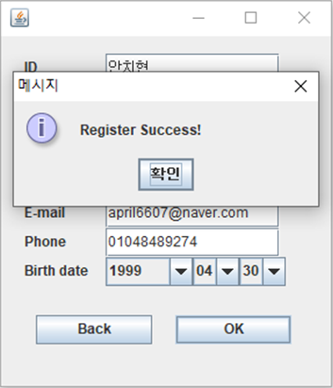
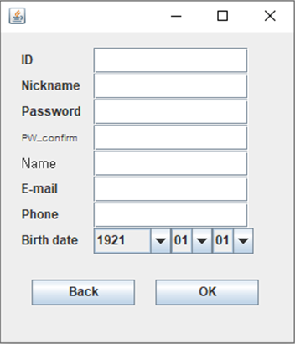
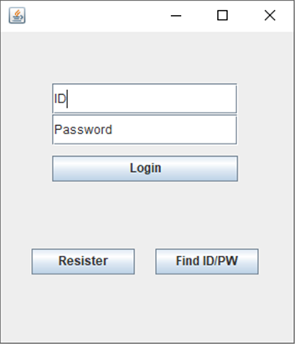
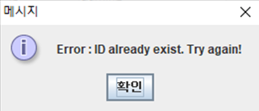
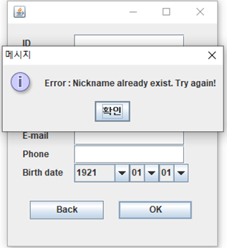
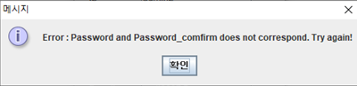

Join Process
>
>
Notes:
1. Register 버튼 click -> 입력 후 ok button click
2. register success -> 로그인 화면으로 돌아옴
3. Error 아이디중복/닉네임중복 위로 돌아감

Slide 5
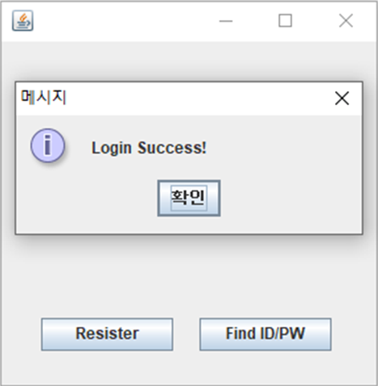
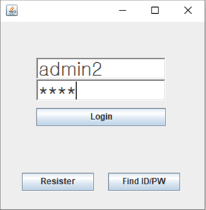
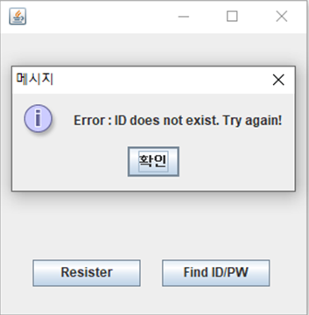
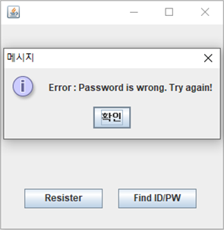
Login Process
>
>

Slide 6
Join Process (detail)
Pass the encrypted password to server
Password RSA encryption
Public key
N, e
>
>
STEP. 1
Server provides public key N and e on initial client execution
STEP. 2
Password RSA encryption with public key when registering from client
STEP. 3
Pass the encrypted password to the server instead of the password entered at the time of successful subscription and save public key together
Notes:
1. 최초 클라이언트 실행 시 서버에서 public key N과 e를 제공
2. 클라이언트에서 register할 때 public key로 password RSA 암호화
3. 가입성공시, 입력한 password 대신 암호화된 password를 서버로 전달하고 public key를 함께 저장

Slide 7
Login Process (detail)
Send RSA encrypted password to server
Pass the public key to client
Pass only ID to server
Login success
>
>
>
STEP. 1
If you enter id and password, pass only id to server
STEP. 2
Pass the public key used at the time of subscription to the client after checking the existence of id
STEP. 3
Encrypt RSA and send password entered to server when logging in with passed public key
STEP. 4
Successful login when password match
Notes:
1. id와 비번 입력하면 id만 서버에 전달
2. id 존재 여부 확인 후 확인되면 가입 시 사용된 public key를 클라이언트로 전달
3. 전달된 public key로 로그인할 때 입력한 password RSA암호화해서 서버로 전송
4. 비밀번호 일치 시 로그인 성공

Slide 8
Protocols
[Client -> Server]
[Server -> Client]
SearchUsers
RequestUserData
AddFriend
CreateChatRoom
InviteChatRoom
JoinChatRoom
ExitChatRoom
SendChat
Refresh
FriendList
FriendLog
ChatRoomList
UserList
Invite
MESSAGE
PublicData
>
>

Slide 9
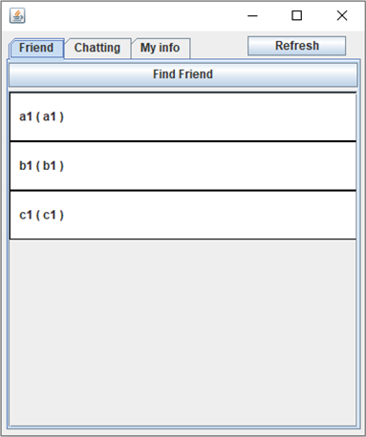
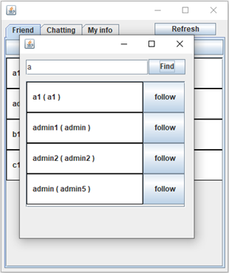
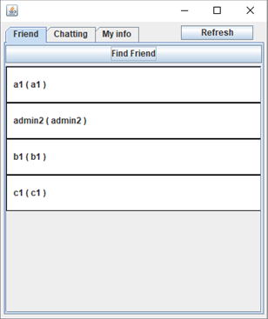
Friend
>
>

Slide 10
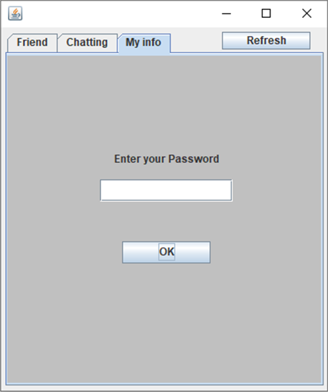
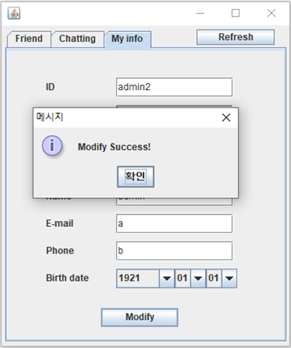
My information

Slide 11
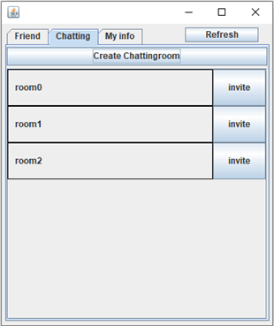
Chatting room

Slide 12


Role
고형종
안치현
이지원
201935005
Network server
201935071
Network client
201935112
Database, ppt

Slide 13
Thank you
Github : https://github.com/leedfdf/networkterm
https://github.com/khjj07/NetworkTermProject
https://github.com/april6607/NetworkTermProject
Youtube : https://youtu.be/BZkANFXCBvU

